Slide 1
PROJECT
EMPLOYEE ABSENTEEISM ANALYTICS

Slide 2
PROJECT
EMPLOYEE ABSENTEEISM ANALYTICS

Slide 3
Agenda
Business Problem
Insights
Recommendations

Slide 4
Agenda
Business Problem
Financial Implication
Data Collection
Influential Factors
Insights
Criticality
Gaps
Recommendations
Quick wins
Policy

Slide 5
Agenda
Business Problem
Insights
Recommendations

Slide 6
Business Problem
How big is the Absenteeism Problem?
$1,533,717
Annually

Slide 7
Business Problem
How big is the Absenteeism Problem?
$11.42
Based on Minimum Wages in Canada (USD)
8336
The waste increases as the headcount grows

Slide 8
Business Problem
How do we process the Data?
Generate Models
Process
Add more data
.csv
Clean
XL Analysis
Import to R
Coordinates DB
Dump
+ Justification

Slide 9
Business Problem
Data
Cleaning

Slide 10
Business Problem
Data
Cleaning
Age ends
Duplicate Values
Unknown Cities
Length of Service
Gender

Slide 11
Insights
Gender equity

Slide 12
Insights
Highest Jobs in Tenure

Slide 13
Agenda
Business Problem
Insights
Recommendations

Slide 14
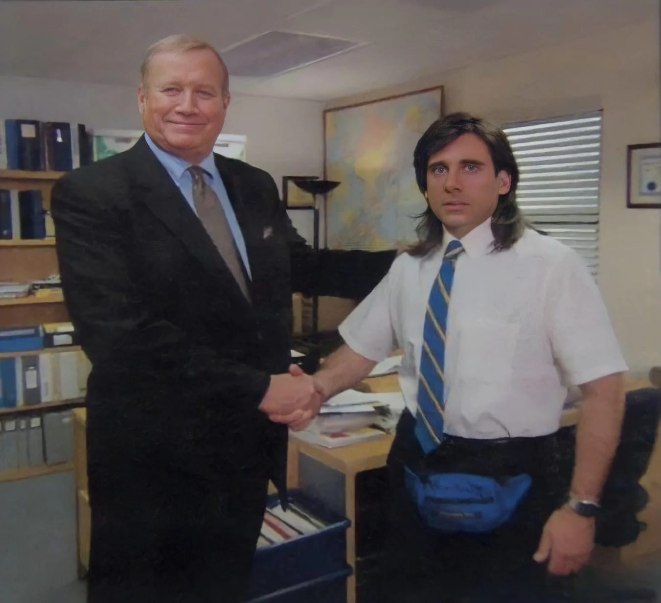
Gender Equality
Random Fictitious Data

Slide 15

Absenteeism and age
Insights

Slide 16

Absenteeism and length service
Insights

Slide 17
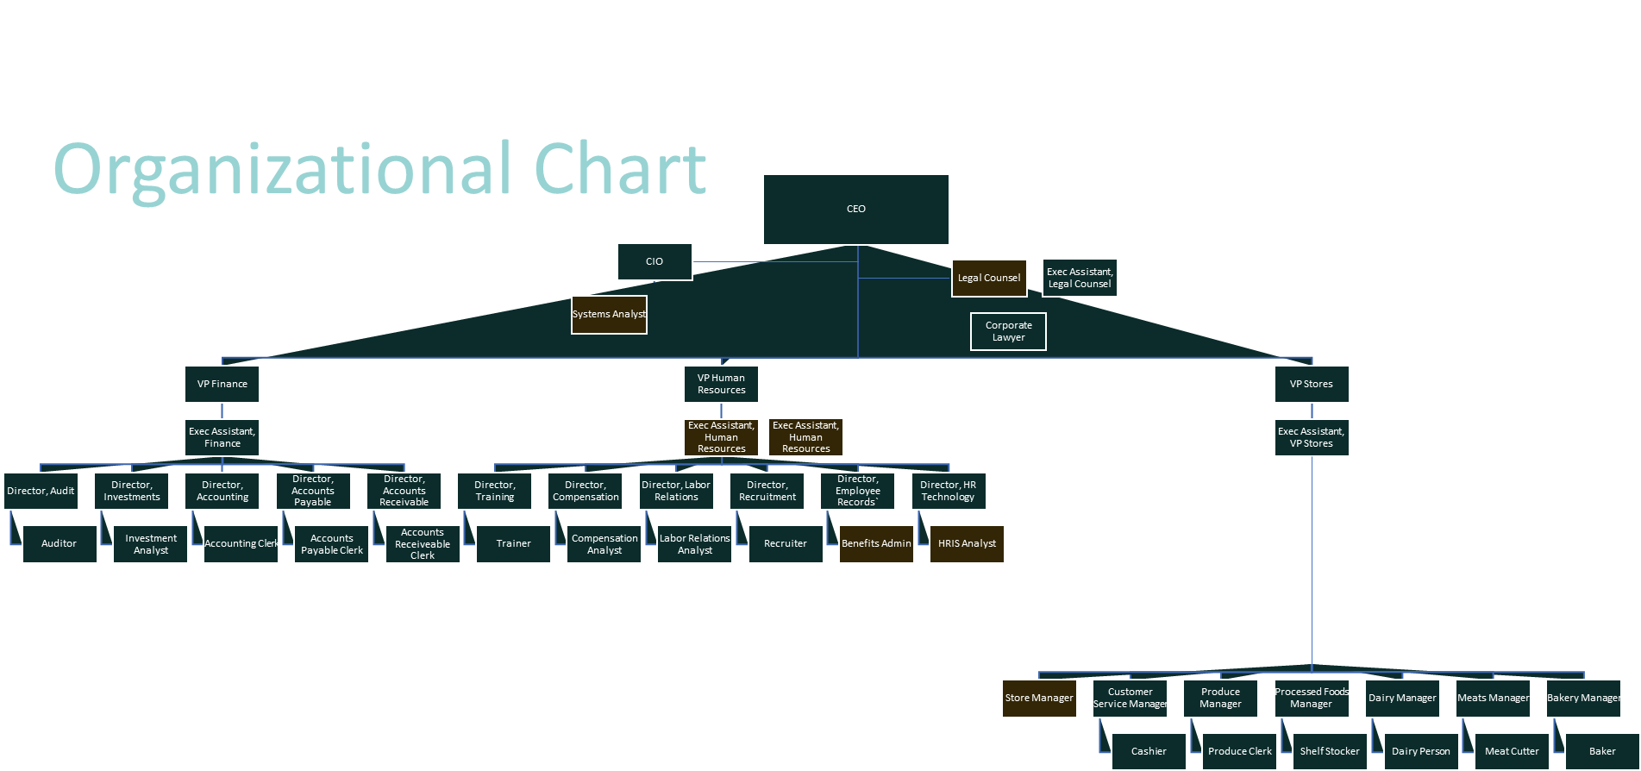
Insights

Slide 18
Insights

Slide 19
Insights
Tenure Bottleneck
VP
9 years
Director
18 years
Manager
5 years

Slide 20
Insights
Tenure Bottleneck
Manager
Director
VP
5 Years
18 Years
9 Years

Slide 21
Insights
Predictive
Analytics

Slide 22
Insights
Predictive
Analytics
Criteria
Response Variable
Ideal model

Slide 23
Agenda
Business Problem
Insights
Recommendations

Slide 24

Quick Wins
Recommendations
For the front-end employees (cashier, baker, dairy person), offer performance-rewards programs as incentives for employees who reach 3 years tenure service.
This Photo by Unknown Author is licensed under CC BY-SA-NC

Slide 25
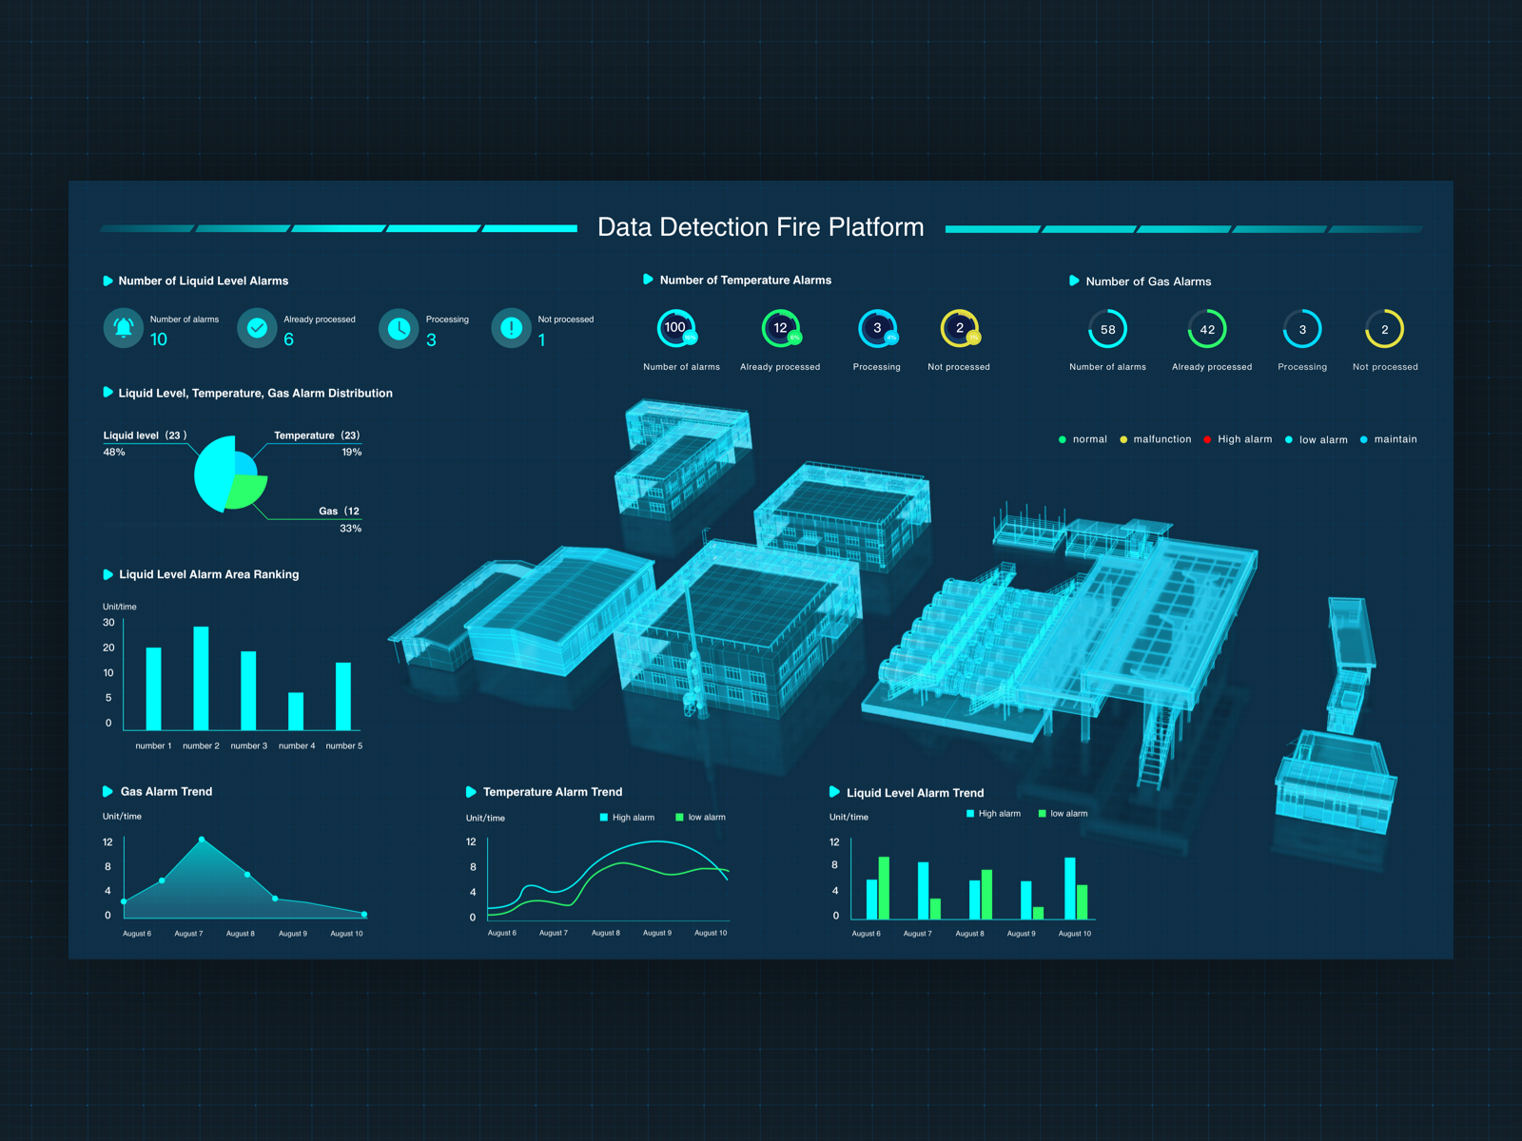
Quick Wins
Recommendations
Reform HR departments’ data collection, and storage.

Slide 26

Recommendations
Hiring Policy
Front-line employees
18-20 in Vancouver 17,307 hr/year
18-22 in Richmond 2,654 hr/year

Slide 27

PROJECT
EMPLOYEE ABSENTEEISM ANALYTICS
Thank you!
This Photo by Unknown Author is licensed under CC BY-SA-NC

Slide 28
Recommendations
Hiring Policy
If deployed in Vancouver, it can reduce the overall cashier abs hrs by (%) (hrs) and overall company to (x hrs) in year 1 alone.

Slide 29
Insights
Organizational Chart
CEO
CIO
Legal Counsel
Exec Assistant, Legal Counsel
Systems Analyst
Corporate Lawyer
VP Finance
VP Human Resources
VP Stores
Exec Assistant, Finance
Exec Assistant, Human Resources
Exec Assistant, Human Resources
Exec Assistant, VP Stores
Director, Audit
Director, Investments
Director, Accounting
Director, Accounts Payable
Director, Accounts Receivable
Director, Training
Director, Compensation
Director, Labor Relations
Director, Recruitment
Director, Employee Records`
Director, HR Technology
Auditor
Investment Analyst
Accounting Clerk
Accounts Payable Clerk
Accounts Receiveable Clerk
Trainer
Compensation Analyst
Labor Relations Analyst
Recruiter
Benefits Admin
HRIS Analyst
Store Manager
Customer Service Manager
Produce Manager
Processed Foods Manager
Dairy Manager
Meats Manager
Bakery Manager
Cashier
Produce Clerk
Shelf Stocker
Dairy Person
Meat Cutter
Baker

Slide 30
Business Problem
Organizational Chart
CEOx
CIOx
Legal Counselxx
Exec Assistant, Legal Counsel
Systems Analyst
Corporate Lawyer
VP Finance
VP Human Resources
VP Stores
Exec Assistant, Finance
Exec Assistant, Human Resources
Exec Assistant, Human Resources
Exec Assistant, VP Stores
Director, Audit
Director, Investments
Director, Accounting
Director, Accounts Payable
Director, Accounts Receivable
Director, Training
Director, Compensation
Director, Labor Relations
Director, Recruitment
Director, Employee Records`
Director, HR Technology
Auditor
Investment Analyst
Accounting Clerk
Accounts Payable Clerk
Accounts Receiveable Clerk
Trainer
Compensation Analyst
Labor Relations Analyst
Recruiter
Benefits Admin
HRIS Analyst
Store Manager
Customer Service Manager
Produce Manager
Processed Foods Manager
Dairy Manager
Meats Manager
Bakery Manager
Cashier
Produce Clerk
Shelf Stocker
Dairy Person
Meat Cutter
Baker

Slide 31
Recommendations
0 Abs Hrs
If deployed in Vancouver, it can reduce the overall cashier abs hrs by (%) (hrs) and overall company to (x hrs) in year 1 alone.
By year 5:

Slide 32
The Cashier has the highest Absinteesm Culture level. In the city of Vancouver, the age `24.51` y/o and beyond is where Absenteeism hours escalate with a strong correlation for both males and females at a `slope of 0.9395x`. Since our x-intercept is `24.51`, or in other words, Cashiers below the age of 24.51 have no absinteesm hours `(0 Hrs / year)`. The avg. tenure of the Cashier is `4.58 years`. A policy to hire Cashiers of a maximum of `20 y/o` will ensure most cashiers will clear out of the company before they turn 25 and reduce overall company absenteeism significantly. However, we have to validate if these young cashiers are full-time or part-time in order to control the cost associated with high-frequancy and high-volume recruting, plus investigate the compensation increase as a result, along with the total supply of such type of workers.
Quick wins

Slide 33
Steps

Slide 34
Data Cleaning

Slide 35
Tenure Bottleneck
Manager
5 years
VP
9 years
Director
18 years

Slide 36
Tenure Bottleneck
Director
18 years
VP
9 years
Manager
5 years

Slide 37
Organizational Chart
CEO
CIO
VP Finance
VP Human Resources
VP Stores
Exec Assistant, Finance
Exec Assistant, Human Resources
Exec Assistant, VP Stores
Director, Audit
Director, Investments
Director, Accounting
Director, Accounts Payable
Director, Accounts Receivable
Director, Training
Director, Compensation
Director, Labor Relations
Director, Recruitment
Director, Employee Records`
Director, HR Technology
Store Manager
Customer Service Manager
Produce Manager
Processed Foods Manager
Dairy Manager
Meats Manager
Bakery Manager
Systems Analyst
Cashier
Produce Clerk
Shelf Stocker
Dairy Person
Meat Cutter
Baker
Trainer
Compensation Analyst
Labor Relations Analyst
Recruiter
Benefits Admin
HRIS Analyst
Auditor
Investment Analyst
Accounting Clerk
Accounts Payable Clerk
Accounts Receiveable Clerk
Exec Assistant, Legal Counsel
Legal Counsel
Corporate Lawyer

Slide 38
PROJECT
EMPLOYEE ABSENTEEISM ANALYTICS

Slide 39
Data Cleaning

Slide 40
Data Cleaning

Slide 41
Data Cleaning

Slide 42
Steps

Slide 43
Steps

